Slide 1
Rachel and Lee’s Quiz
10 rounds of 5 questions
Each answer is worth 1 point
The rounds are as follows:
General Knowledge
Logos
Film and TV
Food and Drink
Country Shapes
Science and Nature
Children’s TV
Sport
Music
2020

Slide 2
General Knowledge
1. Who is 6th in line to the British throne?

Slide 3
General Knowledge
2. Who is Donald Trump’s vice president?

Slide 4
General Knowledge
3. Which singer has the most UK number one singles ever?

Slide 5
General Knowledge
4. What language is spoken in Lapland?

Slide 6
General Knowledge
5. What happened in the 1914 Christmas day truce during the First World War?

Slide 7

Logos
1.

Slide 8

Logos
2.

Slide 9

Logos
3.

Slide 10

Logos
4.

Slide 11

Logos
5.

Slide 12
Film and TV
1. What does Tom Hanks compare life to in Forrest Gump?

Slide 13
Film and TV
2. Who directed Titanic, Avatar
and The Terminator?

Slide 14
Film and TV
3. Which Blackadder character always had a cunning plan?

Slide 15
Film and TV
4. In Beauty and the Beast,
what is Mrs Potts’ son called?

Slide 16
Film and TV
5. Which character dresses up as an armadillo in the Friends episode ‘The One with the
Holiday Armadillo’?

Slide 17
Food and Drink
1. Which vitamin is the only one
not found in an egg?

Slide 18
Food and Drink
2. What alcohol is in a Pina Colada?

Slide 19
Food and Drink
3. What type of food is Pumpernickle?

Slide 20
Food and Drink
4. What drink is known as
‘Glühwein’ in Germany?

Slide 21
Food and Drink
5. Which ruler is said to have banned mince pies in Britain in the 1600s?

Slide 22
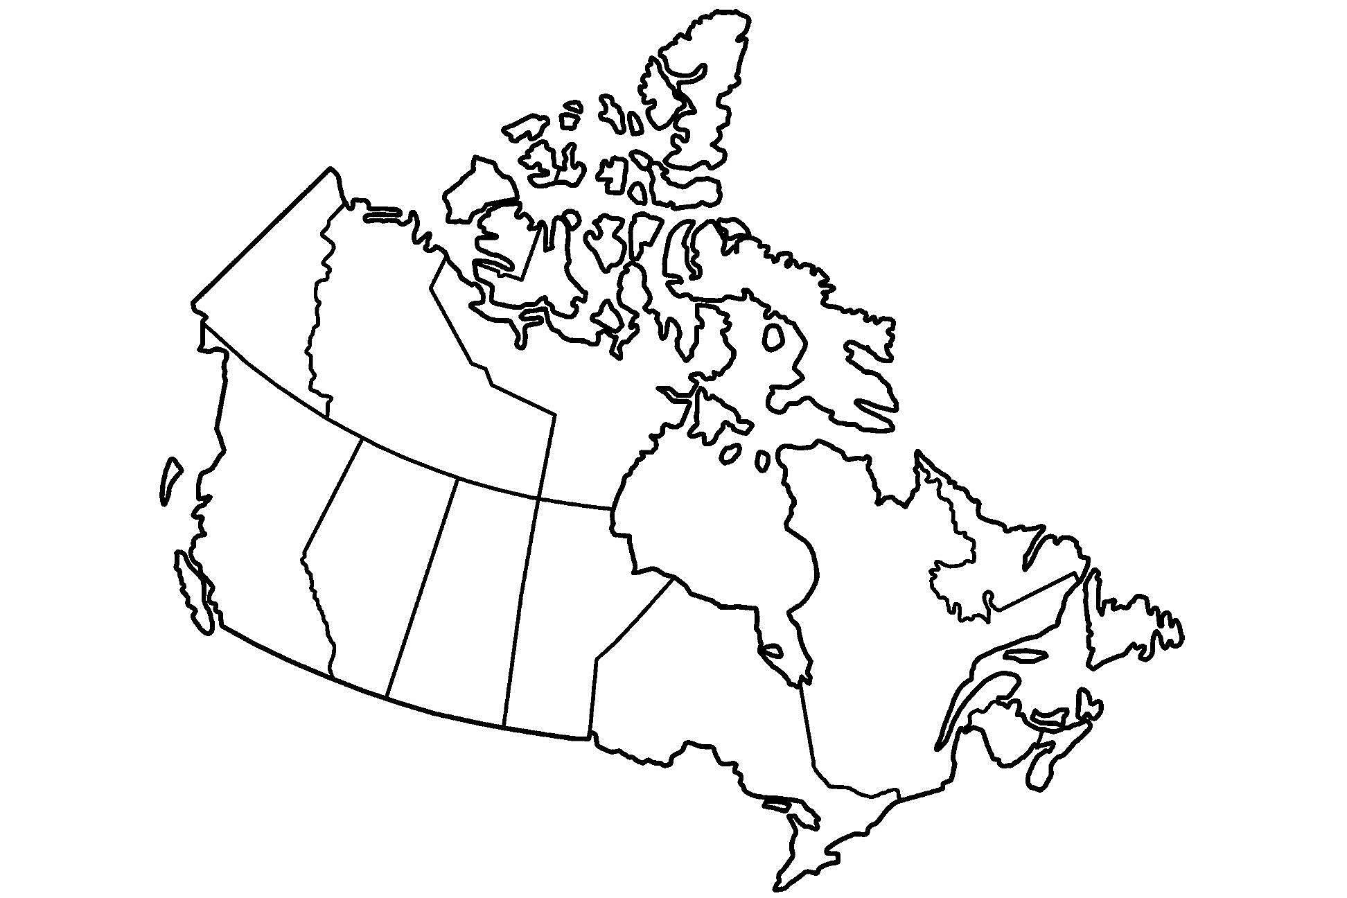
Country shapes
1.

Slide 23
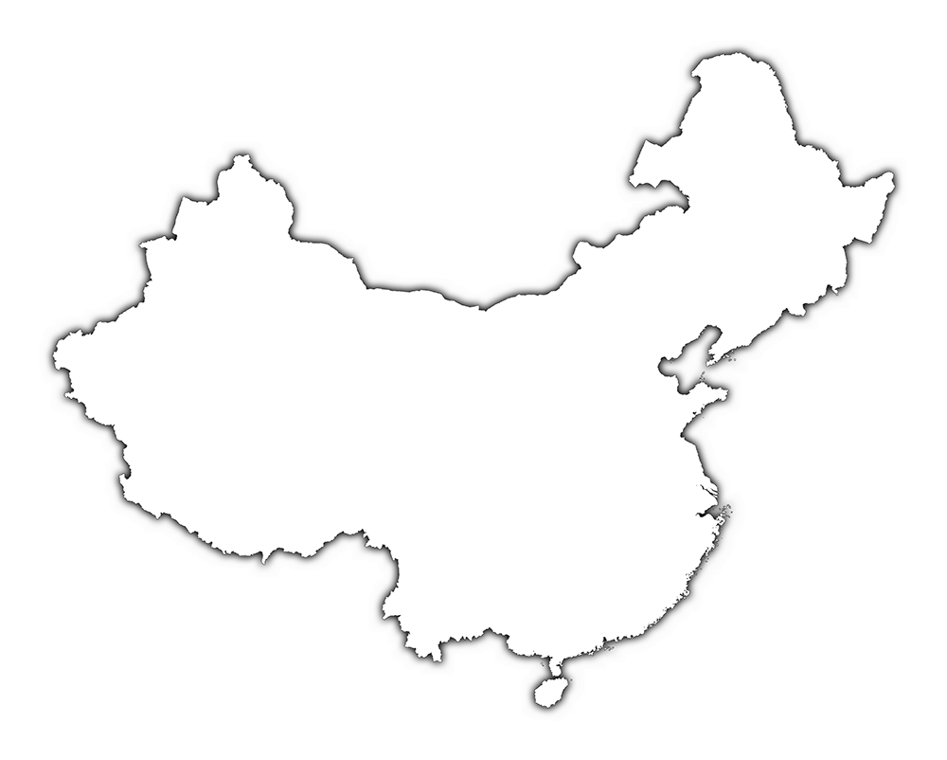
Country shapes
2.

Slide 24
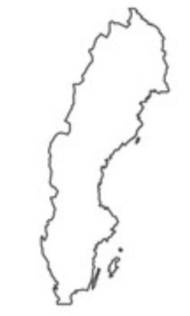
Country shapes
3.

Slide 25
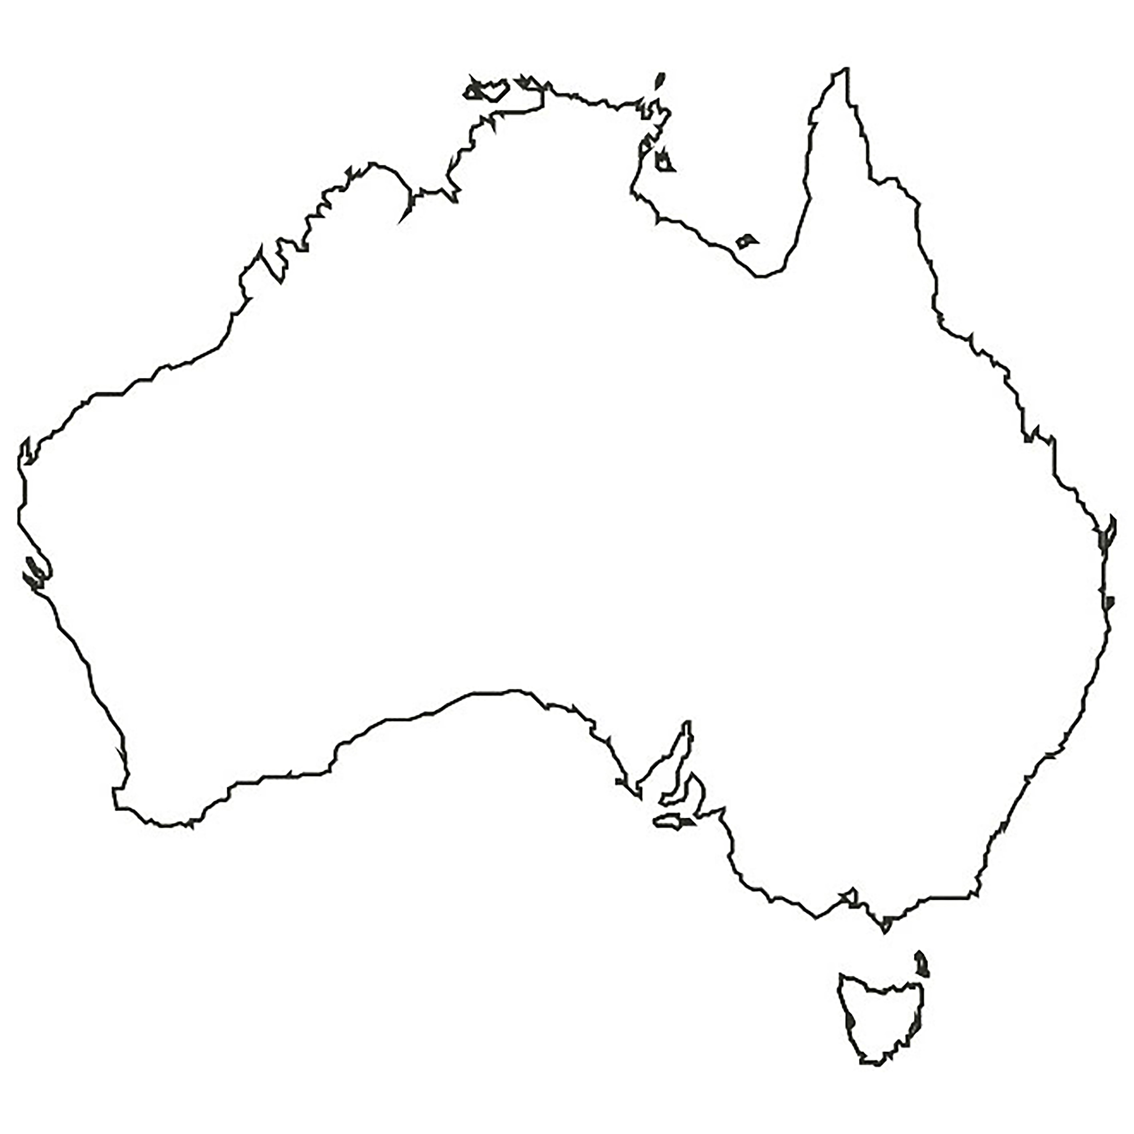
Country shapes
4.

Slide 26
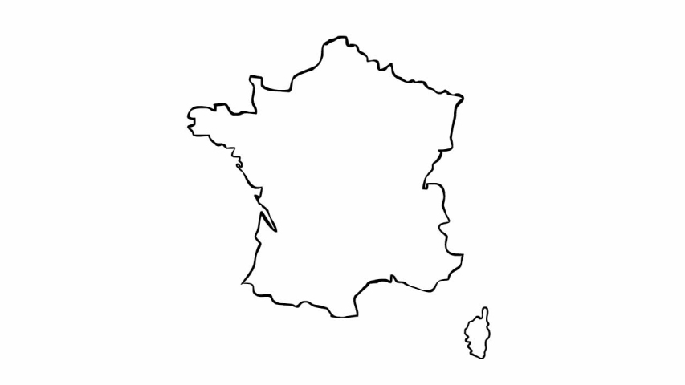
Country shapes
5.

Slide 27
Science and Nature
1. Which part of the body is affected by rhinitis?

Slide 28
Science and Nature
2. Which mammal cannot jump?

Slide 29
Science and Nature
3. What is the chemical symbol for copper?

Slide 30
Science and Nature
4. In the nativity story, which animal carried Mary before she gave birth to Jesus?

Slide 31
Science and Nature
5. Which plant based Christmas tradition was started by servants in Victorian Britain?

Slide 32
Children’s TV
1. Which ‘Tot’ from Tots TV had blue hair?

Slide 33
Children’s TV
2. Who is Peppa Pig’s teacher?

Slide 34
Children’s TV
3. What children’s BBC show has been giving
out badges for decades?

Slide 35
Children’s TV
4. Who plays Scrooge in
The Muppets Christmas Carol?

Slide 36
Children’s TV
5. The 2012 follow-up to The Snowman is called The Snowman and what?

Slide 37
Sport
1. The Pittsburgh Penguins play which sport?

Slide 38
Sport
2. What is Usain Bolt’s
world record time for 100m?
a) 9.58 seconds
b) 9.71 seconds
c) 9.87 seconds

Slide 39
Sport
3. Which football team is nicknamed The Tigers?

Slide 40
Sport
4. How many players are there in a
rugby league team?

Slide 41
Sport
5. The Boxing Day Test match is traditionally played in which country?

Slide 42
Music
1. ‘You Spin Me Round (Like A Record Baby)’ is a song by which British band?

Slide 43
Music
2. Which song begins:
‘When I was 6 years old I broke my leg…’
(only song title needed, not artist)

Slide 44
Music
3. Eurovision sensation ABBA came from
which country?

Slide 45
Music
4. Which song begins:
‘I don’t want a lot for Christmas…’
(only song title needed, not artist)

Slide 46
Music
5. How many gifts in total were given in the
‘12 Days Of Christmas’?

Slide 47
2020
1. In January, which film won the Oscar for Best Picture?

Slide 48
2020
2. Which father named their baby X Æ A-12?

Slide 49
2020
3. What is the name of the Netflix documentary about Joe Exotic?

Slide 50
2020
4. Which anniversary did Coronation Street celebrate this year?

Slide 51
2020
5. Who won the
BBC Sports Personality of the Year 2020?

Slide 52
End of Quiz :)
Answers to follow...

Slide 53
General Knowledge
1. Who is 6th in line to the British throne?
Prince Harry

Slide 54
General Knowledge
2. Who is Donald Trump’s vice president?
Mike Pence

Slide 55
General Knowledge
3. Which singer has the most UK number one singles ever?
Elvis Presley

Slide 56
General Knowledge
4. What language is spoken in Lapland?
Finnish or Swedish

Slide 57
General Knowledge
5. What happened in the 1914 Christmas day truce during the First World War?
A football game between British and German soldiers

Slide 58

Logos
1.

Slide 59

Logos
2.

Slide 60

Logos
3.

Slide 61

Logos
4.

Slide 62

Logos
5.

Slide 63
Film and TV
1. What does Tom Hanks compare life to in Forrest Gump?
Box of chocolates

Slide 64
Film and TV
2. Who directed Titanic, Avatar
and The Terminator?
James Cameron

Slide 65
Film and TV
3. Which Blackadder character always had a cunning plan?
Baldrick

Slide 66
Film and TV
4. In Beauty and the Beast,
what is Mrs Potts’ son called?
Chip

Slide 67
Film and TV
5. Which character dresses up as an armadillo in the Friends episode ‘The One with the
Holiday Armadillo’?
Ross

Slide 68
Food and Drink
1. Which vitamin is the only one
not found in an egg?
Vitamin C

Slide 69
Food and Drink
2. What alcohol is in a Pina Colada?
Rum

Slide 70
Food and Drink
3. What type of food is Pumpernickle?
Bread

Slide 71
Food and Drink
4. What drink is known as
‘Glühwein’ in Germany?
Mulled wine

Slide 72
Food and Drink
5. Which ruler is said to have banned mince pies in Britain in the 1600s?
Oliver Cromwell

Slide 73
Country shapes
1.
Canada

Slide 74
Country shapes
2.
China

Slide 75
Country shapes
3.
Sweden

Slide 76
Country shapes
4.
Australia

Slide 77
Country shapes
5.
France

Slide 78
Science and Nature
1. Which part of the body is affected by rhinitis?
Nose

Slide 79
Science and Nature
2. Which mammal cannot jump?
Elephant

Slide 80
Science and Nature
3. What is the chemical symbol for copper?
Cu

Slide 81
Science and Nature
4. In the nativity story, which animal carried Mary before she gave birth to Jesus?
Donkey

Slide 82
Science and Nature
5. Which plant based Christmas tradition was started by servants in Victorian Britain?
Kissing under mistletoe

Slide 83
Children’s TV
1. Which ‘Tot’ from Tots TV had blue hair?
Tom

Slide 84
Children’s TV
2. Who is Peppa Pig’s teacher?
Madame Gazelle

Slide 85
Children’s TV
3. What children’s BBC show has been giving
out badges for decades?
Blue Peter

Slide 86
Children’s TV
4. Who plays Scrooge in
The Muppets Christmas Carol?
Michael Caine

Slide 87
Children’s TV
5. The 2012 follow-up to The Snowman is called The Snowman and what?
The Snowman and the Snowdog

Slide 88
Sport
1. The Pittsburgh Penguins play which sport?
Ice Hockey

Slide 89
Sport
2. What is Usain Bolt’s
world record time for 100m?
a) 9.58 seconds
b) 9.71 seconds
c) 9.87 seconds
2. What is Usain Bolt’s
world record time for 100m?
a) 9.58 seconds
b) 9.71 seconds
c) 9.87 seconds

Slide 90
Sport
3. Which football team is nicknamed The Tigers?
Hull City

Slide 91
Sport
4. How many players are there in a
rugby league team?
Thirteen

Slide 92
Sport
5. The Boxing Day Test match is traditionally played in which country?
Australia

Slide 93
Music
1. ‘You Spin Me Round (Like A Record Baby)’ is a song by which British band?
Dead or Alive

Slide 94
Music
2. Which song begins:
‘When I was 6 years old I broke my leg…’
(only song title needed, not artist)
Castle On The Hill

Slide 95
Music
3. Eurovision sensation ABBA came from
which country?
Sweden

Slide 96
Music
4. Which song begins:
‘I don’t want a lot for Christmas…’
(only song title needed, not artist)
All I Want For Christmas (Is You)

Slide 97
Music
5. How many gifts in total were given in the
‘12 Days Of Christmas’?
364

Slide 98
2020
1. In January, which film won the Oscar for Best Picture?
Parasite

Slide 99
2020
2. Which father named their baby X Æ A-12?
Elon Musk

Slide 100
2020
3. What is the name of the Netflix documentary about Joe Exotic?
Tiger King

Slide 101
2020
4. Which anniversary did Coronation Street celebrate this year?
60th

Slide 102
2020
5. Who won the
BBC Sports Personality of the Year 2020?
Lewis Hamilton

Slide 103
Download this quiz and make it your own
leefuller.io/quiz

